Slide 1


Python Programming Ⅰ
week 9

Slide 2
Python: Input and Output, Standard Library

Slide 3
Python: Input and Output

Slide 4
Topic Structure
Task | Single Value | Multiple Values | numpy, pandas
Presentation (value, variable) | int, float, string, boolean | list, tuple, dictionary, set | ndarray, Series, DataFrame
Operation (algebra) | expressions | operations, mutable operations | expressions, get, set, reshape, …
Control flow | if for while
Use and reuse | Functions Standard libraries Modules and Packages
Input and output | Standard I/O File I/O |  | Standard I/O File I/O CSV, Excel

Slide 5
Learning Objectives
Input and Output
Files
Pickle
Encoding
Data pipeline

Slide 6
Input and Output
You would want to take input from the user and then print some results back.
We can achieve this using the input function and print function respectively.
For output, we can also use the various methods of the str (string) class.
For example, you can use the rjust method to get a string which is right justified to a specified width.
Another common type of input/output is dealing with files.
The ability to create, read and write files is essential to many programs.

Slide 7
Formatted literal string f string: In/Output
x = 1; y = 2
f'{x} is x {y} is y’ # string
print(f'{x} is x {y} is y') # print()는 NoneType을 return
type(print(f'{x} is x {y} is y’))

Slide 8
Raw string, r
Without Raw String: The backslashes(\) are interpreted as escape characters.
path = 'C:\\Users\tAlice\nDocuments\\file.txt'
print(path)
#
C:\Users Alice
Documents\file.txt
With Raw String: The backslashes are treated as literal backslashes(\)
path = r'C:\\Users\tAlice\nDocuments\\file.txt'
print(path)
#
C:\\Users\\Alice\\Documents\\file.txt

Slide 9
Example: Input from User
def reverse(sText):
return sText[::-1] #[1:], [1::]. [2:5], [-1:-4]
def isPalindrome(sText):
sText = sText.upper()
return sText == reverse(sText)
sSomething = input("Enter text: ")
if isPalindrome(sSomething):
print("Yes, it is a palindrome.")
else:
print("No, it is not a palindrome.")
colab에서 reverse.py로 만들고 실행시켜보기
“level",
"SOS",
"rotator",
"nurses run"
“Able was I ere I saw Elba”

Slide 10
Various arguments of Functions
def func(a, b=2, *args, c=3, **kwargs):
print("a:", a) # 일반 인자 (Positional Arguments): 순서
print("b:", b) # 키워드 인자 (Key Arguments): 순서 무시
print("args:", args) # 가변 인자 (Variable Arguments): tuple
print("c:", c)
print("kwargs:", kwargs) # 가변 키워드 인자 (Variable Key Arguments): dict
func(1, 4, 5, 6, c=7, d=8, e=9)
#
a: 1
b: 4
args: (5, 6)
c: 7
kwargs: {'d': 8, 'e': 9}

Slide 11

Various arguments of Functions
def func(*joker1, **joker2):
print("args:", joker1) # 가변 인자 (Variable Arguments): tuple
print("kwargs:", joker2) # 가변 키워드 인자 (Variable Key Arguments): dict
func(1, 4, 5, 6, c=7, d=8, e=9)
#
args: (1, 4, 5, 6)
kwargs: {‘c’: 7, 'd': 8, 'e': 9}

Slide 12
Example: Input and eval()
Make a Python program as below:
Make an expression from the user. For example:
2 + 3
Evaluate the expression and print out the result. For example:
5
Refer to the Python Built-in Functions page:
https://docs.python.org/3/library/functions.html

Slide 13
Example: Input and eval()
sExpression = input("Enter an expression ...like 2+2 or abs(-3) ")
print(eval(sExpression))

Slide 14
try except: A code runs with it
sExpression = input("Enter an expression ... ")
try: # 2+3, str(4)
result = eval(sExpression)
print(result)
except NameError: # a+1, myfunction()
print("Error: the expression includes undefined variables or is not valid.")
except Exception as e: # 10/0, a=1 (not expression but statement)
print(f"An error occurred: {e}")
eval()이 평가할 수 있는 것이 표현식(expression)으로 표현식은 어떤 값을 계산하고 그 결과를 반환할 수 있는 코드: 예를 들어 2 + 3, "hello".upper(), 또는 sum([1, 2, 3])와 같은 것들이 표현식
반면에 "a=1"과 같은 대입문(statement)은 값을 반환하지 않고, 변수에 값을 저장하는 동작을 수행

Slide 15
Example: Input and eval()
while True:
sExpression = input("Enter an expression ... ")
if sExpression == "quit":
break
else:
print(eval(sExpression))

Slide 16
Learning Objectives
Input and Output
Files
Pickle
Encoding
Data pipeline

Slide 17
Files
You can open and use files for reading or writing by creating an object of the file class and using its read, readline or write methods appropriately to read from or write to the file.
The ability to read or write to the file depends on the mode you have specified for the file opening.
When you are finished with the file, you call the close method to tell Python that we are done using the file.

Slide 18


file, data, stream, buffer

Slide 19
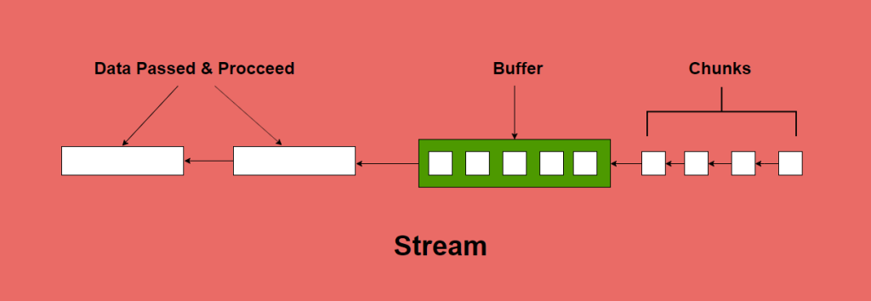
open ~ close

Slide 20
Syntax of I/O Functions
open(file, mode='r', buffering=-1, encoding=None, errors=None, newline=None,
closefd=True, opener=None)
close()
Character | Meaning
'r' | open for reading (default)
'w' | open for writing, truncating the file first
'x' | open for exclusive creation, failing if the file already exists
'a' | open for writing, appending to the end of the file if it exists
'b' | binary mode
't' | text mode (default)
'+' | open for updating (reading and writing)

Slide 21
Syntax of I/O Functions
readline(size=-1)
Read and return one line from the stream.
If size is specified, at most size bytes will be read.
readlines(hint=-1)
Read and return a list of lines from the stream.
No more lines will be read if the total size (in bytes/characters) of all lines so far exceeds hint.
Note that it’s already possible to iterate on file objects using for line in file: ... without calling file.readlines().
read(size=-1)
Read up to size bytes from the object and return them.
If size is unspecified or -1, all bytes until EOF are returned.
write(b)
Write the given bytes-like object, b, to the underlying raw stream, and return the number of bytes written.

Slide 22
Control Flow in Reading from a File
f = open(sFileName)
# f = open(sFileName, "r")
…
str1 = f.readline()
…
str2 = f.readline()
…
strN = f.readline()
…
f.close()

Slide 23
Control Flow in Reading from a File
f = open(sFileName) # Open for "r"eading
# f = open(sFileName, "r") # If no mode is specified, "r"ead mode is assumed by default
…
str1 = f.readline()
…
str2 = f.readline()
…
strN = f.readline()
…
f.close()

Slide 24
Control Flow in Reading from a File
f = open(sFileName)
# f = open(sFileName, "r")
…
str1 = f.readline() # Read a line from file
…
str2 = f.readline()
…
strN = f.readline()
…
f.close()

Slide 25
Control Flow in Reading from a File
f = open(sFileName)
# f = open(sFileName, "r")
…
str1 = f.readline()
…
str2 = f.readline() # Read a line from file
…
strN = f.readline()
…
f.close()

Slide 26
Control Flow in Reading from a File
f = open(sFileName)
# f = open(sFileName, "r")
…
str1 = f.readline()
…
str2 = f.readline()
…
strN = f.readline() # Read a line from file
…
f.close()

Slide 27
Control Flow in Reading from a File
f = open(sFileName)
# f = open(sFileName, "r")
…
str1 = f.readline()
…
str2 = f.readline()
…
strN = f.readline()
… # Zero length indicates EOF
f.close()

Slide 28
Control Flow in Reading from a File
f = open(sFileName)
# f = open(sFileName, "r")
…
str1 = f.readline()
…
str2 = f.readline()
…
strN = f.readline()
…
f.close() # Close the file

Slide 29
Example: Control Flow in Reading from a File
poem.txt
f = open("poem.txt", encoding="utf-8")
str1 = f.readline()
str2 = f.readline()
str3 = f.readline()
print(str1)
print(str2)
print(str3)
f.close()
That Arizona sky burnin' in your eyes You look at me and, babe, I wanna catch on fire It's buried in my soul like California gold You found the light in me that I couldn't find
So when I'm all choked up And I can't find the words Every time we say goodbye Baby, it hurts When the sun goes down And the band won't play I'll always remember us this way
저렇게 많은 별 중에서
별 하나가 나를 내려다본다
이렇게 많은 사람 중에서
그 별 하나를 쳐다본다
밤이 깊을수록
별은 밝음 속에서 사라지고
나는 어둠 속에서 사라진다
이렇게 정다운
너 하나 나 하나는
어디서 무엇이 되어
다시 만나랴

Slide 30


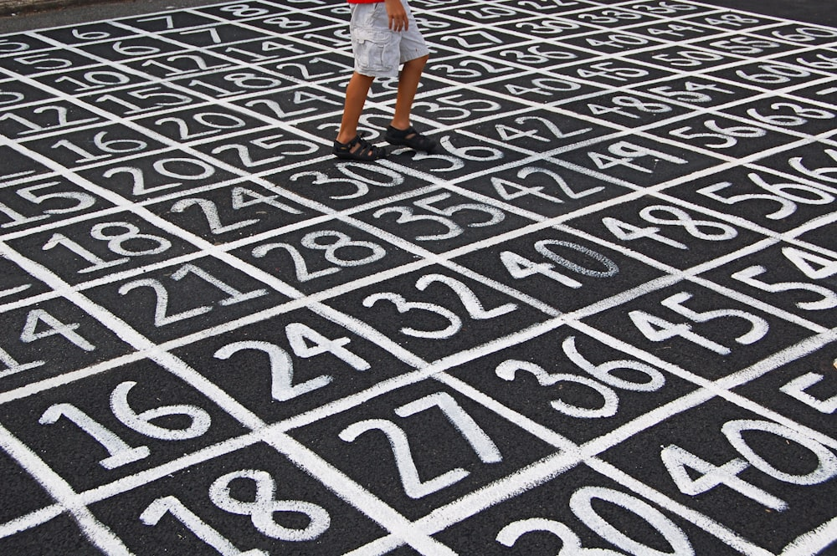
Numeric & String(character)

Slide 31

Character Encoding Method
ASCII는 영문자에 국한된 오래된 인코딩(사람이 입력한 문자나 기호를 컴퓨터가 이해할 수 있는 신호로 만드는 것, decoding은 그 반대)한 표준화된 부호체계
Unicode는 전 세계 모든 문자를 포괄할 수 있도록 설계된 광범위한 문자 집합
UTF-8은 Unicode의 실질적인 구현 방식 중 하나로, 네트워크와 파일 저장에서 널리 사용되며, 다양한 길이의 바이트를 사용해 전 세계의 거의 모든 문자를 표현할

Slide 32
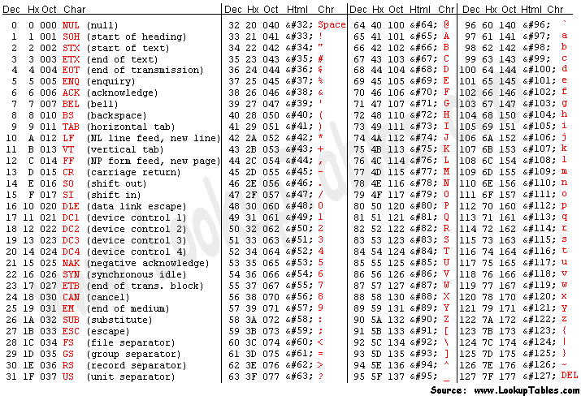
Character Encoding Method
char = 'a'
# 십진법
decimal = ord(char)
# 이진법
binary = bin(decimal)
# 16진법
hexadecimal = hex(decimal)
# HTML 엔티티
html_entity = f"&#{decimal};"
print(f"십진법: {decimal}")
print(f"이진법: {binary}")
print(f"16진법: {hexadecimal}")
print(f"HTML 엔티티: {html_entity}")

Slide 33
Example: Control Flow in Reading from a File
f = open("poem.txt")
while True:
sLine = f.readline()
if len(sLine) == 0:
break
else:
print(sLine, end='')
f.close()

Slide 34
Example: Control Flow in Reading from a File
f = open("poem.txt")
while True:
sline = f.readline()
if len(sline) == 0:
break
else:
print(sline, end='')
f.close()

Slide 35
Example: Control Flow in Reading from a File
f = open("poem.txt")
while True:
sline = f.readline()
if len(sline) == 0: # Zero length indicates EOF
break
else:
print(sline, end='')
f.close()

Slide 36
Example: Control Flow in Reading from a File
f = open("poem.txt")
while True:
sline = f.readline()
if len(sline) == 0: # Zero length indicates EOF
break
else:
print(sline, end='')
f.close()

Slide 37
Example: Control Flow in Reading from a File
f = open("poem.txt")
while True:
sline = f.readline()
if len(sline) == 0: # Zero length indicates EOF
break
else:
print(sline, end='') # The 'sLine' already has a newline since it is reading from a file.
f.close()

Slide 38
Example: Control Flow in Reading from a File
f = open("poem.txt")
while True:
sline = f.readline()
if len(sline) == 0: # Zero length indicates EOF
break
else:
print(sline, end='')
f.close()

Slide 39
Example: Control Flow in Reading from a File
f = open("poem.txt")
while True:
sline = f.readline()
if len(sline) == 0: # Zero length indicates EOF
break
else:
print(sline, end='')
f.close()

Slide 40
Example: Control Flow in Reading from a File
f = open("poem.txt")
while True:
sLine = f.readline()
if len(sLine) == 0:
break
else:
print(sLine, end='')
f.close()

Slide 41
Example: readlines()
f = open("poem.txt")
l = f.readlines()
f.close()
print(l)
➔
["That Arizona sky burnin' in your eyes\n", 'You look at me and, babe, I wanna catch on fire\n', "It's buried in my soul like California gold\n", "You found the light in me that I couldn't find\n", "So when I'm all choked up\n", "And I can't find the words\n", 'Every time we say goodbye\n', 'Baby, it hurts\n', 'When the sun goes down\n', "And the band won't play\n", "I'll always remember us this way"]

Slide 42
Example: readlines()
f = open("poem.txt")
l = f.readlines()
for sLine in l:
print(sLine, end='')
f.close()

Slide 43
Example: readlines()
f = open("poem.txt")
l = f.readlines()
for sLine in l:
print(sLine, end='')
f.close()
f = open("poem.txt")
while True:
sLine = f.readline()
if len(sLine) == 0:
break
else:
print(sLine, end='')
f.close()

Slide 44
Example: readlines()
f = open("poem.txt")
l = f.readlines()
for sLine in l:
print(sLine, end='')
f.close()
f = open("poem.txt")
while True:
sLine = f.readline()
if len(sLine) == 0:
break
else:
print(sLine, end=‘’)
f.close()

Slide 45
Example: readlines()
f = open("poem.txt")
l = f.readlines()
for sLine in l:
print(sLine, end='')
f.close()
➔
f = open("poem.txt")
for sLine in f.readlines():
print(sLine, end='')
f.close()
➔
f = open("poem.txt")
for sLine in f:
print(sLine, end='')
f.close()

Slide 46
Example: readlines()
f = open("poem.txt")
for sLine in f:
print(sLine, end='')
f.close()
f = open("poem.txt")
l = f.readlines()
for sLine in l:
print(sLine, end='')
f.close()

Slide 47
Example: readlines()
f = open("poem.txt")
for sLine in f:
print(sLine, end='')
f.close()
f = open("poem.txt")
l = f.readlines()
for sLine in l:
print(sLine, end='')
f.close()

Slide 48
Example: read()
f = open("poem.txt")
sText = f.read()
f.close()
print(sText)
➔
That Arizona sky burnin' in your eyes
You look at me and, babe, I wanna catch on fire
It's buried in my soul like California gold
You found the light in me that I couldn't find
So when I'm all choked up
And I can't find the words
Every time we say goodbye
Baby, it hurts
When the sun goes down
And the band won't play
I'll always remember us this way

Slide 49
Example: read()
f = open("poem.txt")
sText = f.read()
# print(sText)
l = sText.split("\n")
f.close()
print(l)
➔
["That Arizona sky burnin' in your eyes", 'You look at me and, babe, I wanna catch on fire', "It's buried in my soul like California gold", "You found the light in me that I couldn't find", "So when I'm all choked up", "And I can't find the words", 'Every time we say goodbye', 'Baby, it hurts', 'When the sun goes down', "And the band won't play", "I'll always remember us this way"]

Slide 50
Example: read()
f = open("poem.txt")
sText = f.read()
l = sText.split("\n")
f.close()
print(l)
f = open("poem.txt")
l = f.readlines()
f.close()
print(l)

Slide 51
Example: read()
f = open("poem.txt")
sText = f.read()
l = sText.split("\n")
f.close()
print(l)
f = open("poem.txt")
l = f.readlines()
f.close()
print(l)

Slide 52
Control Flow in Writing to a File
f = open(sFileName, "w")
…
f.write(str1)
…
f.write(str2)
…
f.write(strN)
…
f.close()

Slide 53
Control Flow in Writing to a File
f = open(sFileName, "w") # Open for "w"riting at current directory
…
f.write(str1)
…
f.write(str2)
…
f.write(strN)
…
f.close()

Slide 54
Control Flow in Writing to a File
f = open(sFileName, "w")
…
f.write(str1) # Write text to file
…
f.write(str2)
…
f.write(strN)
…
f.close()

Slide 55
Control Flow in Writing to a File
f = open(sFileName, "w")
…
f.write(str1)
…
f.write(str2) # Write text to file
…
f.write(strN)
…
f.close()

Slide 56
Control Flow in Writing to a File
f = open(sFileName, "w")
…
f.write(str1)
…
f.write(str2)
…
f.write(strN) # Write text to file
…
f.close()

Slide 57
Control Flow in Writing to a File
f = open(sFileName, "w")
…
f.write(str1)
…
f.write(str2)
…
f.write(strN)
…
f.close() # Close the file

Slide 58
Example: Control Flow in Writing to a File
sPoem = '''\
Programming is fun
When the work is done
if you wanna make your work also fun:
use Python!
'''
f = open("poem.txt", "w")
f.write(sPoem)
f.write(sPoem)
f.write(sPoem)
f.close()

Slide 59
Example: Control Flow in Writing to a File
sPoem = '''\
Programming is fun
When the work is done
if you wanna make your work also fun:
use Python!
'''
f = open("poem.txt", "w")
f.write(sPoem)
f.write(sPoem)
f.write(sPoem)
f.close()

Slide 60
Example: Control Flow in Writing to a File
sPoem = '''\
Programming is fun
When the work is done
if you wanna make your work also fun:
use Python!
'''
f = open("poem.txt", "w")
f.write(sPoem)
f.write(sPoem)
f.write(sPoem)
f.close()

Slide 61
Example: Control Flow in Writing to a File
sZen = '''\
The Zen of Python
Beautiful is better than ugly.
Explicit is better than implicit.
Simple is better than complex.
Complex is better than complicated.'''
f = open("../../../zen.txt", "w")
f.write(sPoem)
f.write(sPoem)
f.write(sPoem)
f.close()
# import os
# "data/images" 디렉토리 생성(상대/절대 주소)
# os.makedirs(“./../data/images", exist_ok=True)

Slide 62
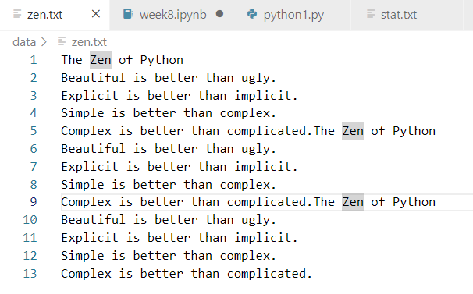
Example: Control Flow in Writing to a File

Slide 63
Example: Prime Numbers
import math
def isPrime(n):
if n <= 1:
return False
for d in range(2, int(math.sqrt(n)) + 1):
if n % d == 0:
return False
return True
f = open(“./data/prime.txt", "w") # 현재 폴더에서 위로 가서 data 폴더
for n in range(2, 10001):
if isPrime(n):
f.write("{0:5d}\n".format(n))
f.close()

Slide 64
Learning Objectives
Input and Output
Files
Pickle (다음에 공부하기)
Encoding
Data pipeline

Slide 65
Pickle
Python provides a standard module called pickle which you can use to store any plain Python object in a file and then get it back later.
This is called storing the object persistently.

Slide 66
Control Flow in Storing Data to a File
import pickle
f = open(sFileName, "wb")
…
pickle.dump(dData1, f)
…
pickle.dump(dData2, f)
…
pickle.dump(dDataN, f)
…
f.close()

Slide 67
Control Flow in Storing Data to a File
import pickle
f = open(sFileName, "wb") # Open for "b"inary "w"riting
…
pickle.dump(dData1, f)
…
pickle.dump(dData2, f)
…
pickle.dump(dDataN, f)
…
f.close()

Slide 68
Control Flow in Storing Data to a File
import pickle
f = open(sFileName, "wb")
…
pickle.dump(dData1, f) # Dump the object to file
…
pickle.dump(dData2, f)
…
pickle.dump(dDataN, f)
…
f.close()

Slide 69
Control Flow in Storing Data to a File
import pickle
f = open(sFileName, "wb")
…
pickle.dump(dData1, f)
…
pickle.dump(dData2, f) # Dump the object to file
…
pickle.dump(dDataN, f)
…
f.close()

Slide 70
Control Flow in Storing Data to a File
import pickle
f = open(sFileName, "wb")
…
pickle.dump(dData1, f)
…
pickle.dump(dData2, f)
…
pickle.dump(dDataN, f) # Dump the object to file
…
f.close()

Slide 71
Control Flow in Storing Data to a File
import pickle
f = open(sFileName, "wb")
…
pickle.dump(dData1, f)
…
pickle.dump(dData2, f)
…
pickle.dump(dDataN, f)
…
f.close() # Close the file

Slide 72
Example: Control Flow in Storing Data to a File
import pickle
a = ["a", 1, "b"]
b = ("a", 1, "b")
c = set(["a", 1, "b"])
d = {1: 2, 2: 3, 3: "k"}
f = open("p.data", "wb")
pickle.dump(a, f)
pickle.dump(b, f)
pickle.dump(c, f)
pickle.dump(d, f)
f.close()

Slide 73
Example: Control Flow in Storing Data to a File
import pickle
a = ["a", 1, "b"]
b = ("a", 1, "b")
c = set(["a", 1, "b"])
d = {1: 2, 2: 3, 3: "k"}
f = open("p.data", "wb")
pickle.dump(a, f)
pickle.dump(b, f)
pickle.dump(c, f)
pickle.dump(d, f)
f.close()

Slide 74
Example: Control Flow in Storing Data to a File
import pickle
a = ["a", 1, "b"]
b = ("a", 1, "b")
c = set(["a", 1, "b"])
d = {1: 2, 2: 3, 3: "k"}
f = open("p.data", "wb")
pickle.dump(a, f)
pickle.dump(b, f)
pickle.dump(c, f)
pickle.dump(d, f)
f.close()

Slide 75
Example: Control Flow in Storing Data to a File
import pickle
a = ["a", 1, "b"]
b = ("a", 1, "b")
c = set(["a", 1, "b"])
d = {1: 2, 2: 3, 3: "k"}
f = open("p.data", "wb")
pickle.dump(a, f)
pickle.dump(b, f)
pickle.dump(c, f)
pickle.dump(d, f)
f.close()

Slide 76
Example: Control Flow in Storing Data to a File
import pickle
a = ["a", 1, "b"]
b = ("a", 1, "b")
c = set(["a", 1, "b"])
d = {1: 2, 2: 3, 3: "k"}
f = open("p.data", "wb")
pickle.dump(a, f)
pickle.dump(b, f)
pickle.dump(c, f)
pickle.dump(d, f)
f.close()

Slide 77
Example: Control Flow in Storing Data to a File
import pickle
a = ["a", 1, "b"]
b = ("a", 1, "b")
c = set(["a", 1, "b"])
d = {1: 2, 2: 3, 3: "k"}
f = open("p.data", "wb")
pickle.dump(a, f)
pickle.dump(b, f)
pickle.dump(c, f)
pickle.dump(d, f)
f.close()

Slide 78
Example: Control Flow in Storing Data to a File
import pickle
a = ["a", 1, "b"]
b = ("a", 1, "b")
c = set(["a", 1, "b"])
d = {1: 2, 2: 3, 3: "k"}
f = open("p.data", "wb")
pickle.dump(a, f)
pickle.dump(b, f)
pickle.dump(c, f)
pickle.dump(d, f)
f.close()

Slide 79
Control Flow in Loading Data from a File
import pickle
f = open(sFileName, "rb")
…
dData1 = pickle.load(f)
…
dData2 = pickle.load(f)
…
dDataN = pickle.load(f)
…
f.close()

Slide 80
Control Flow in Loading Data from a File
import pickle
f = open(sFileName, "rb") # Open for "b"inary "r"eading
…
dData1 = pickle.load(f)
…
dData2 = pickle.load(f)
…
dDataN = pickle.load(f)
…
f.close()

Slide 81
Control Flow in Loading Data from a File
import pickle
f = open(sFileName, "rb")
…
dData1 = pickle.load(f) # Load the object from file
…
dData2 = pickle.load(f)
…
dDataN = pickle.load(f)
…
f.close()

Slide 82
Control Flow in Loading Data from a File
import pickle
f = open(sFileName, "rb")
…
dData1 = pickle.load(f)
…
dData2 = pickle.load(f) # Load the object from file
…
dDataN = pickle.load(f)
…
f.close()

Slide 83
Control Flow in Loading Data from a File
import pickle
f = open(sFileName, "rb")
…
dData1 = pickle.load(f)
…
dData2 = pickle.load(f)
…
dDataN = pickle.load(f) # Load the object from file
…
f.close()

Slide 84
Control Flow in Loading Data from a File
import pickle
f = open(sFileName, "rb")
…
dData1 = pickle.load(f)
…
dData2 = pickle.load(f)
…
dDataN = pickle.load(f)
…
f.close() # Close the file

Slide 85
Example: Control Flow in Loading Data from a File
import pickle
f = open("p.data", "rb")
a = pickle.load(f)
b = pickle.load(f)
c = pickle.load(f)
d = pickle.load(f)
f.close()
print(a)
print(b)
print(c)
print(d)

Slide 86
Example: Control Flow in Loading Data from a File
import pickle
f = open("p.data", "rb")
a = pickle.load(f)
b = pickle.load(f)
c = pickle.load(f)
d = pickle.load(f)
f.close()
print(a)
print(b)
print(c)
print(d)

Slide 87
Example: Control Flow in Loading Data from a File
import pickle
f = open("p.data", "rb")
a = pickle.load(f)
b = pickle.load(f)
c = pickle.load(f)
d = pickle.load(f)
f.close()
print(a)
print(b)
print(c)
print(d)

Slide 88
Example: Control Flow in Loading Data from a File
import pickle
f = open("p.data", "rb")
a = pickle.load(f)
b = pickle.load(f)
c = pickle.load(f)
d = pickle.load(f)
f.close()
print(a)
print(b)
print(c)
print(d)

Slide 89
Example: Control Flow in Loading Data from a File
import pickle
f = open("p.data", "rb")
a = pickle.load(f)
b = pickle.load(f)
c = pickle.load(f)
d = pickle.load(f)
f.close()
print(a)
print(b)
print(c)
print(d)

Slide 90
Example: Control Flow in Loading Data from a File
import pickle
f = open("p.data", "rb")
a = pickle.load(f)
b = pickle.load(f)
c = pickle.load(f)
d = pickle.load(f)
f.close()
print(a)
print(b)
print(c)
print(d)

Slide 91
Example: Control Flow in Loading Data from a File
import pickle
f = open("p.data", "rb")
a = pickle.load(f)
b = pickle.load(f)
c = pickle.load(f)
d = pickle.load(f)
f.close()
print(a)
print(b)
print(c)
print(d)

Slide 92
Learning Objectives
Input and Output
Files
Pickle
Encoding
Data pipeline

Slide 93
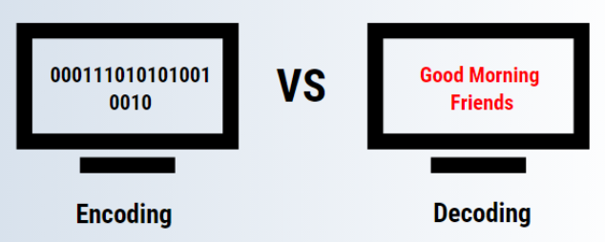
Encoding - Decoding
Encoding : 문자를 수자로
the process of putting a sequence of characters (letters, numbers, punctuation, and certain symbols) into a specialized format for efficient transmission or storage.
Decoding : 수자를 문자로
the conversion of an encoded format back into the original sequence of characters.

Slide 94
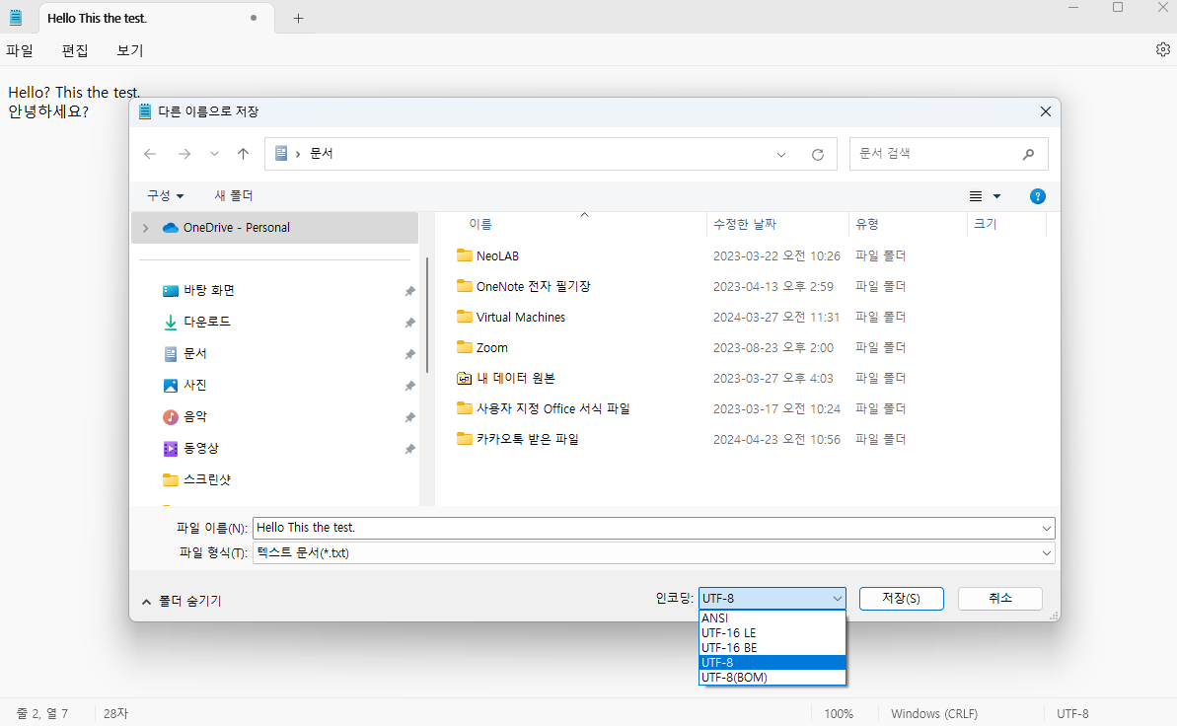
Encoding

Slide 95
Example: Encoding
import io
f = io.open("abc.txt", "rt", encoding="utf-8")
s = f.readlines()
f.close()
print(s)

Slide 96
Example: Encoding
import io
f = io.open("abc.txt", "rt", encoding="ANSI")
s = f.readlines()
f.close()
print(s)

Slide 97
Example: Encoding
import io
# 파일을 쓰기 모드("w")로 열고 텍스트 모드("t")로 처리
f = io.open("abc.txt", "wt", encoding="utf-8")
f.write("Hello? This is a test.\n안녕하세요? 이것은 테스트입니다.")
f.close()
sText = io.open("abc.txt", "rt", encoding="utf-8").read()
print(sText)

Slide 98
Example: Encoding
import io
f = io.open("abc.txt", "wt", encoding="utf-8")
f.write("Hello? This is a test.\n안녕하세요? 이것은 테스트입니다.")
f.close()
sText = io.open("abc.txt", "rt", encoding="utf-8").read()
print(sText)
You may use encoding="utf-8" or encoding="euc-kr" for Korean, when encoding="ANSI" does not work.

Slide 99
Example: Encoding
import io
f = io.open("abc.txt", "wt", encoding="utf-8")
f.write("Hello? This is a test.\n안녕하세요? 이것은 테스트입니다.")
f.close()
sText = io.open("abc.txt", "rt", encoding="utf-8").read()
print(sText)

Slide 100
Example: Encoding
import io
f = io.open("abc.txt", "wt", encoding="utf-8")
f.write("Hello? This is a test.\n안녕하세요? 이것은 테스트입니다.")
f.close()
sText = io.open("abc.txt", "rt", encoding="utf-8").read()
print(sText)

Slide 101
Example: Encoding
import io
f = io.open("abc.txt", "wt", encoding="utf-8")
f.write(u"Hello? This is a test.\n안녕하세요? 이것은 테스트입니다.")
f.close()
sText = io.open("abc.txt", "rt", encoding="utf-8").read()
print(sText)
You may use Unicode literals by putting a u before the string.

Slide 102
Example: Encoding
import io
f = io.open("abc.txt", "wt", encoding="utf-8")
f.write(u"Hello? This is a test.\n안녕하세요? 이것은 테스트입니다.")
f.close()
sText = io.open("abc.txt", "rt", encoding="utf-8").read()
print(sText)

Slide 103
Summary
Input and Output
Files
Pickle
Encoding
Data pipeline

Slide 104

End of Python: Input and Output

Slide 105
Appendix. Data Pipeline

Slide 106

Pipeline
origin
destination
flow

Slide 107
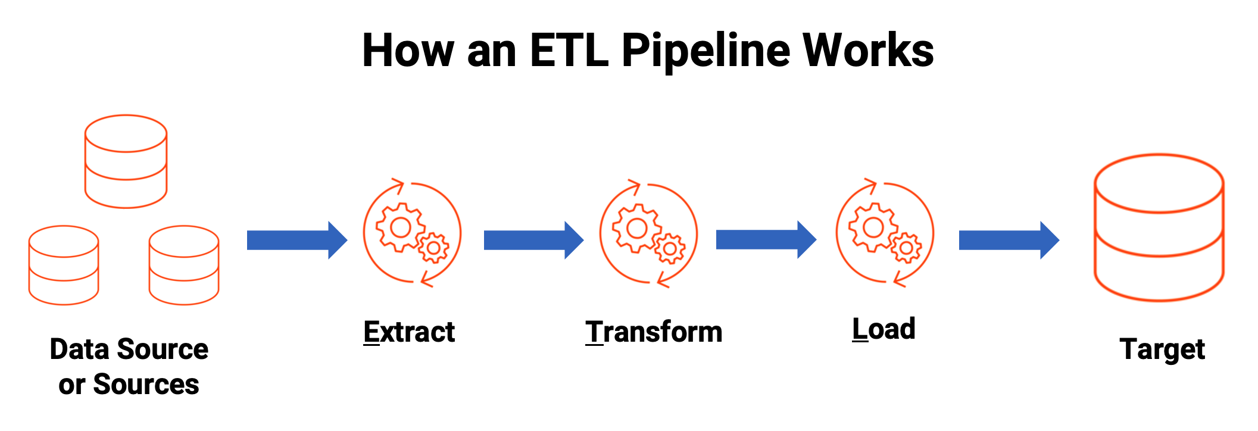
data pipeline
https://www.informatica.com/in/resources/articles/what-is-etl-pipeline.html

Slide 108
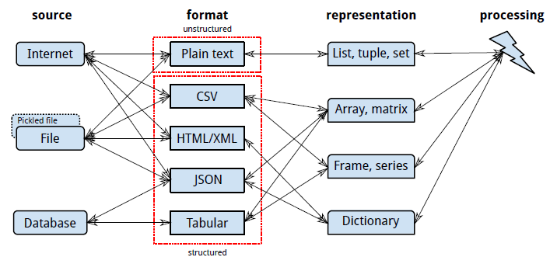
Data Acquisition Pipeline

Slide 109
Tabular Text Files
A separator, or delimiter, character like tab ('\t'), comma (','), or vertical bar('|'). This is an example of the comma-separated values (CSV) format.
'<' and '>' around tags. Examples include XML and HTML.
Punctuation. An example is JavaScript Object Notation (JSON).
Indentation. An example is YAML (which is recursively defined as “YAML Ain’t Markup Language”).

Slide 110
CSV
import csv
villains = [
['Doctor', 'No'],
['Rosa', 'Klebb'],
['Mister', 'Big'],
['Auric', 'Goldfinger'],
['Ernst', 'Blofeld'],
]
# a context manager with open('../img1/villains', 'wt') as fout:
csvout = csv.writer(fout)
csvout.writerows(villains)
with open('../img1/villains', 'rt') as fin:
cin = csv.reader(fin)
villains = [row for row in cin] # a list comprehension
print(villains)
# Proper file path with error handling
try:
# ensure no extra newlines are inserted
with open('../img1/villains.csv', 'w', newline='') as fout:
csvout = csv.writer(fout)
csvout.writerows(villains)
except IOError as e:
print(f"An error occurred while writing the file: {e}")

Slide 111
CSV
import csv
with open('villains', 'rt') as fin:
cin = csv.DictReader(fin,
fieldnames=['first', 'last'])
villains = [row for row in cin]
print(villains)
# Proper file path with error handling
import pandas as pd
df = pd.DataFrame(villains)
print(df)
first last
0 Doctor No
1 Rosa Klebb
2 Mister Big
3 Auric Goldfinger
4 Ernst Blofeld
[{'first': 'Doctor', 'last': 'No'}, {'first': 'Rosa', 'last': 'Klebb'}, {'first': 'Mister', 'last': 'Big'}, {'first': 'Auric', 'last': 'Goldfinger'}, {'first': 'Ernst', 'last': 'Blofeld'}]

Slide 112
XML
Delimited files convey only two dimensions: rows (lines) and columns (fields within a line).
If you want to exchange data structures among programs, you need a way to encode hierarchies, sequences, sets, and other structures as text.
xml_content = '''<?xml version="1.0"?>
<menu>
<breakfast hours="7-11">
<item price="$6.00">breakfast burritos</item>
<item price="$4.00">pancakes</item>
</breakfast>
<lunch hours="11-3">
<item price="$5.00">hamburger</item>
</lunch>
<dinner hours="3-10">
<item price="$8.00">spaghetti</item>
</dinner>
</menu>
'''
# Save the XML content to a file
file_path = '../img1/menu.xml’
try:
with open(file_path, 'w') as file:
file.write(xml_content)
print(f"XML content successfully written to {file_path}")
except IOError as e:
print(f"An error occurred while writing the file: {e}")

Slide 113
XML
XML is often used for data feeds and messages and has subformats like RSS and Atom.
xml_content = '''<?xml version="1.0"?>
<menu>
<breakfast hours="7-11">
<item price="$6.00">breakfast burritos</item>
<item price="$4.00">pancakes</item>
</breakfast>
<lunch hours="11-3">
<item price="$5.00">hamburger</item>
</lunch>
<dinner hours="3-10">
<item price="$8.00">spaghetti</item>
</dinner>
</menu>
'''
import xml.etree.ElementTree as et
tree = et.ElementTree(file='../img1/menu.xml')
root = tree.getroot()
print(root.tag) for child in root:
print('tag:', child.tag, 'attributes:', child.attrib)
for grandchild in child:
print('\ttag:', grandchild.tag, 'attributes:', grandchild.attrib)
print(len(root)) # number of menu sections
print(len(root[0])) # number of breakfast items
print(len(root[1])) # number of lunch items

Slide 114
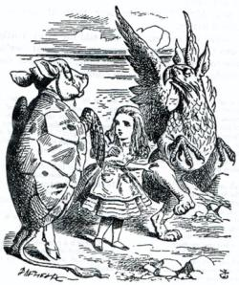
HTML
xml_content = '''<?xml version="1.0"?>
<menu>
<breakfast hours="7-11">
<item price="$6.00">breakfast burritos</item>
<item price="$4.00">pancakes</item>
</breakfast>
<lunch hours="11-3">
<item price="$5.00">hamburger</item>
</lunch>
<dinner hours="3-10">
<item price="$8.00">spaghetti</item>
</dinner>
</menu>
'''
from bs4 import BeautifulSoup
# Write the XML content to an HTML file
with open('../img1/menu.html', 'w') as file:
file.write(xml_content)
# Read the HTML file with BeautifulSoup
with open('../img1/menu.html', 'r') as file:
soup = BeautifulSoup(file, 'html.parser')
# Extract and print out the menu items
for item in soup.find_all('item'):
print(f'{item.text}: {item.get("price")}')
https://www.crummy.com/software/BeautifulSoup/bs4/doc/

Slide 115
JSON
menu = \
{
"breakfast":
{
"hours": "7-11",
"items": {
"breakfast burritos": "$6.00",
"pancakes": "$4.00"
}
},
"lunch" :
{
"hours": "11-3",
"items": {
"hamburger": "$5.00"
}
},
"dinner":
{"hours": "3-10",
"items": {
"spaghetti": "$8.00"
}
}
}
import json
# python dictionary is converted to JSON-formatted string
menu_json = json.dumps(menu)
# output the JSON string to the console
print(menu_json)
# takes the JSON string menu_json and parses it back into a dictionary.
menu2 = json.loads(menu_json)
print(menu2)

Slide 116
YAML
name:
first: James
last: McIntyre
dates:
birth: 1828-05-25
death: 1906-03-31
details:
bearded: true
themes: [cheese, Canada]
books:
url: http://www.gutenberg.org/files/36068/36068-h/36068-h.htm
poems:
- title: 'Motto'
text: |
Politeness, perseverance and pluck,
To their possessor will bring good luck.
- title: 'Canadian Charms'
text: |
Here industry is not in vain,
For we have bounteous crops of grain,
And you behold on every field
Of grass and roots abundant yield,
But after all the greatest charm
Is the snug home upon the farm,
And stone walls now keep cattle warm.
import yaml
with open('../img1/mcintyre.yaml', 'rt') as fin:
text = fin.read()
data = yaml.safe_load(text)
print(data['details'])
print(len(data['poems']))
print(data['poems'][1]['title'])
{'bearded': True, 'themes': ['cheese', 'Canada']}
2
Canadian Charms

Slide 117
with-statement
# Dump an object into a file
with open("myData.pickle", "wb") as oFile:
pickle.dump(object, oFile)
# Load the same object back
with open("myData.pickle", "rb") as iFile:
object = pickle.load(iFile)
https://realpython.com/python-with-statement/#managing-resources-in-python

Slide 118
Python: Standard Library

Slide 119
Topic Structure
Task | Single Value | Multiple Values | numpy, pandas
Presentation (value, variable) | int, float, string, boolean | list, tuple, dictionary, set | ndarray, Series, DataFrame
Operation (algebra) | expressions | operations, mutable operations | expressions, get, set, reshape, …
Control flow | if for while
Use and reuse | Functions Standard libraries Modules and Packages
Input and output | Standard I/O File I/O |  | Standard I/O File I/O CSV, Excel

Slide 120
Learning Objectives
Standard Library
Built-in Functions
The sys Module

Slide 121
Standard Library
The Python Standard Library contains a huge number of useful modules and is part of every standard Python installation.
It is important to become familiar with the Python Standard Library since many problems can be solved quickly if you are familiar with the range of things that these libraries can do.
You can find complete details for all of the modules in the Python Standard Library in the 'Library Reference' section of the documentation that comes with your Python installation.

Slide 122
Learning Objectives
Standard Library
Built-in Functions
The sys Module

Slide 123
Built-in Functions
abs() | dict() | help() | min() | setattr()
all() | dir() | hex() | next() | slice()
any() | divmod() | id() | object() | sorted()
ascii() | enumerate() | input() | oct() | staticmethod()
bin() | eval() | int() | open() | str()
bool() | exec() | isinstance() | ord() | sum()
bytearray() | filter() | issubclass() | pow() | super()
bytes() | float() | iter() | print() | tuple()
callable() | format() | len() | property() | type()
chr() | frozenset() | list() | range() | vars()
classmethod() | getattr() | locals() | repr() | zip()
compile() | globals() | map() | reversed() | __import__()
complex() | hasattr() | max() | round()
delattr() | hash() | memoryview() | set()

Slide 124
Built-in Functions
abs() | dict() | help() | min() | setattr()
all() | dir() | hex() | next() | slice()
any() | divmod() | id() | object() | sorted()
ascii() | enumerate() | input() | oct() | staticmethod()
bin() | eval() | int() | open() | str()
bool() | exec() | isinstance() | ord() | sum()
bytearray() | filter() | issubclass() | pow() | super()
bytes() | float() | iter() | print() | tuple()
callable() | format() | len() | property() | type()
chr() | frozenset() | list() | range() | vars()
classmethod() | getattr() | locals() | repr() | zip()
compile() | globals() | map() | reversed() | __import__()
complex() | hasattr() | max() | round()
delattr() | hash() | memoryview() | set()

Slide 125
Built-in Functions
abs() | dict() | help() | min() | setattr()
all() | dir() | hex() | next() | slice()
any() | divmod() | id() | object() | sorted()
ascii() | enumerate() | input() | oct() | staticmethod()
bin() | eval() | int() | open() | str()
bool() | exec() | isinstance() | ord() | sum()
bytearray() | filter() | issubclass() | pow() | super()
bytes() | float() | iter() | print() | tuple()
callable() | format() | len() | property() | type()
chr() | frozenset() | list() | range() | vars()
classmethod() | getattr() | locals() | repr() | zip()
compile() | globals() | map() | reversed() | __import__()
complex() | hasattr() | max() | round()
delattr() | hash() | memoryview() | set()

Slide 126
Example: sum()
print(sum([1, 2, 3])) # 6
print(sum((1, 2, 3))) # 6
print(sum(set([1, 2, 3]))) # 6
print(sum({1: "a", 2: "b"})) # 3

Slide 127
Built-in Functions
abs() | dict() | help() | min() | setattr()
all() | dir() | hex() | next() | slice()
any() | divmod() | id() | object() | sorted()
ascii() | enumerate() | input() | oct() | staticmethod()
bin() | eval() | int() | open() | str()
bool() | exec() | isinstance() | ord() | sum()
bytearray() | filter() | issubclass() | pow() | super()
bytes() | float() | iter() | print() | tuple()
callable() | format() | len() | property() | type()
chr() | frozenset() | list() | range() | vars()
classmethod() | getattr() | locals() | repr() | zip()
compile() | globals() | map() | reversed() | __import__()
complex() | hasattr() | max() | round()
delattr() | hash() | memoryview() | set()

Slide 128
Example: type()
print(type(1)) # <class 'int'>
print(type(1.0)) # <class 'float'>
print(type(True)) # <class 'bool'>
print(type("a")) # <class 'str'>
print(type([1, 2, 3])) # <class 'list'>
print(type((1, 2, 3))) # <class 'tuple'>
print(type(set([1, 2, 3]))) # <class 'set'>
print(type({1: "a", 2: "b"})) # <class 'dict'>

Slide 129
End of Python: Input and Output, Standard Library

